Slide 1
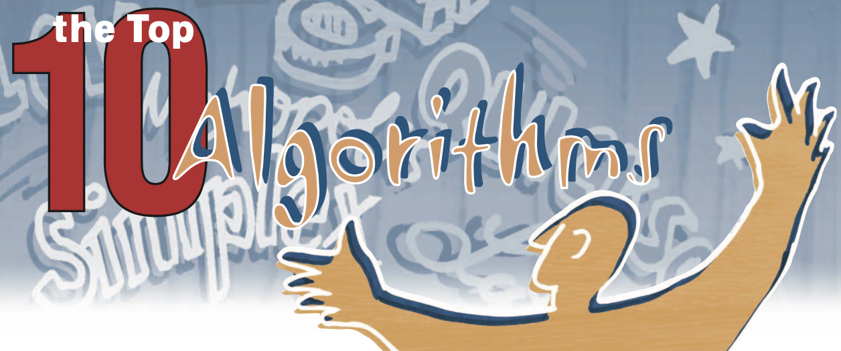
Fast Fourier Transforms (FFT algorithms) MIT course 18.335, spring 2021 Steven G. Johnson MIT Applied Math
“the most important numerical algorithm of our lifetime”
— Gil Strang, MIT
one of
“Top 10 Algorithms of 20th Century”
Jack Dongarra & F. Sullivan, Computing in Science and Engineering (2000)

Slide 2
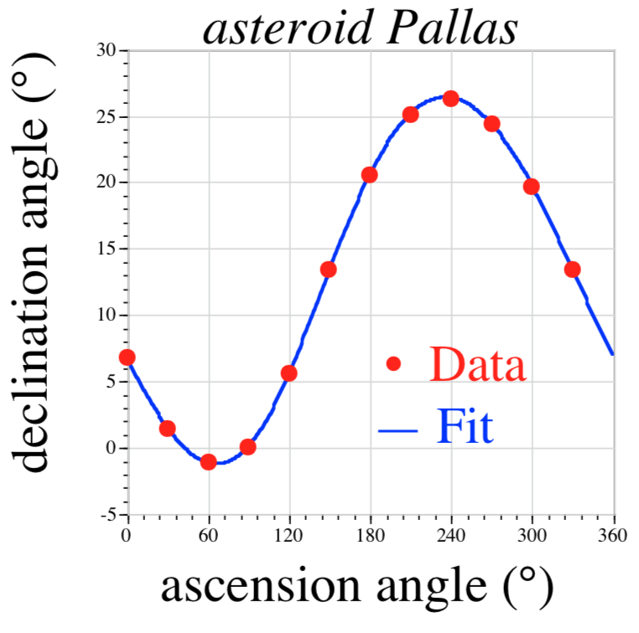
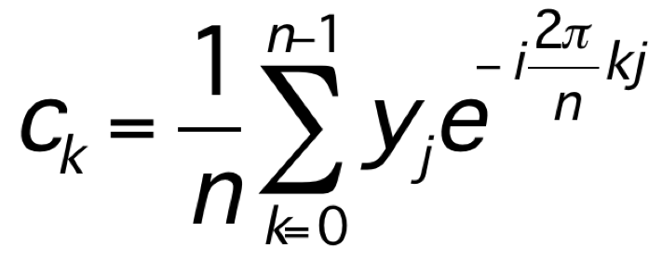
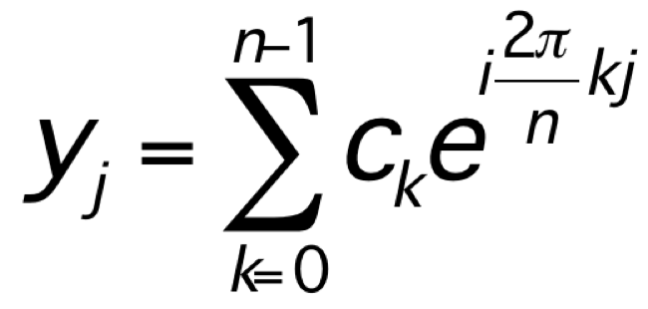
In the beginning (c. 1805): Carl Friedrich Gauss
trigonometric interpolation:
generalizing work
of Clairaut (1754)
and Lagrange (1762)
discrete Fourier transform (DFT):
(before Fourier)

Slide 3
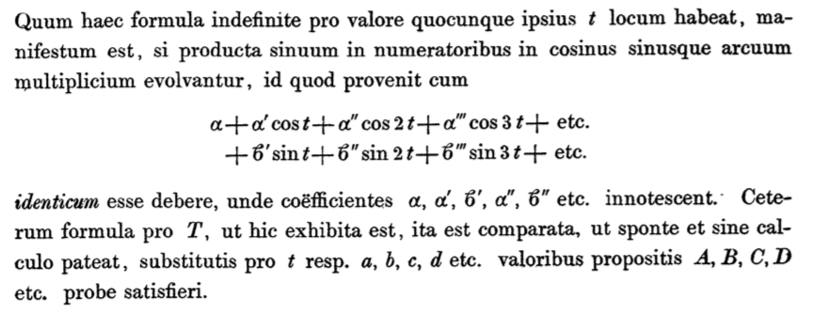
Gauss’ DFT notation:
From “Theoria interpolationis methodo nova tractata”
Kids: don’t try this at home!

Slide 4
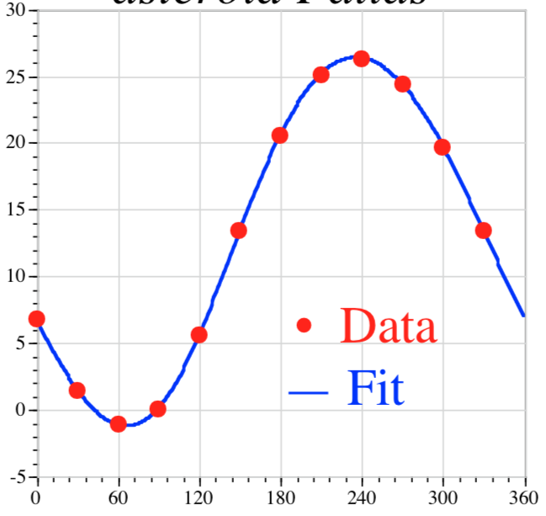
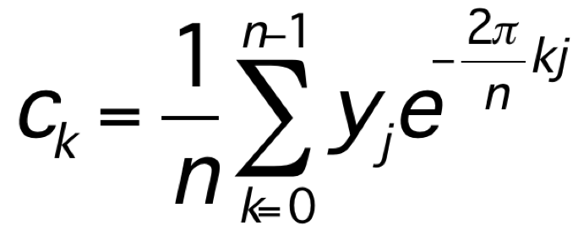
Gauss’ fast Fourier transform (FFT)
?
how do we compute:
— not directly: O(n²) operations … for Gauss, n=12
Gauss’ insight: “Distribuamus hanc periodum primo in tres periodos quaternorum terminorum.”
= We first distribute this period
[n=12] into 3 periods of length 4 …
Divide and conquer.
(any composite n)

Slide 5
But how fast was it?
“illam vero methodum calculi mechanici taedium magis minuere”
= “truly, this method greatly reduces
the tedium of mechanical calculation”
(For Gauss, being less boring was good enough.)

Slide 6
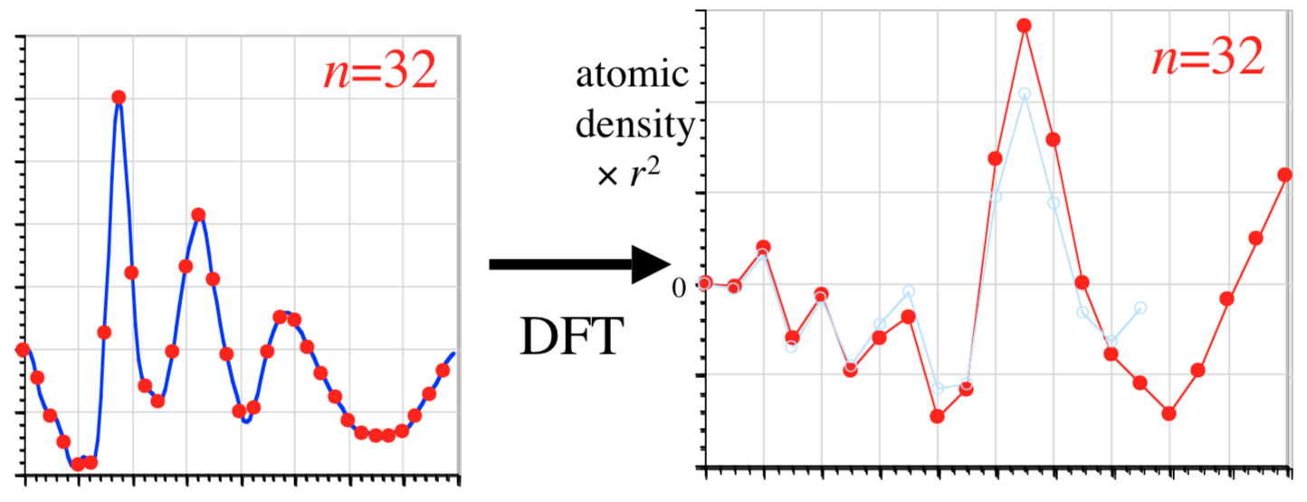
two (of many) re-inventors: Danielson and Lanczos (1942)
[ J. Franklin Inst. 233, 365–380 and 435–452]
Given Fourier transform of density (X-ray scattering) find density:
discrete sine transform (DST-1) = DFT of real, odd-symmetry
sample
the spectrum
at n points:
radius r
…double sampling until density (DFT) converges…

Slide 7
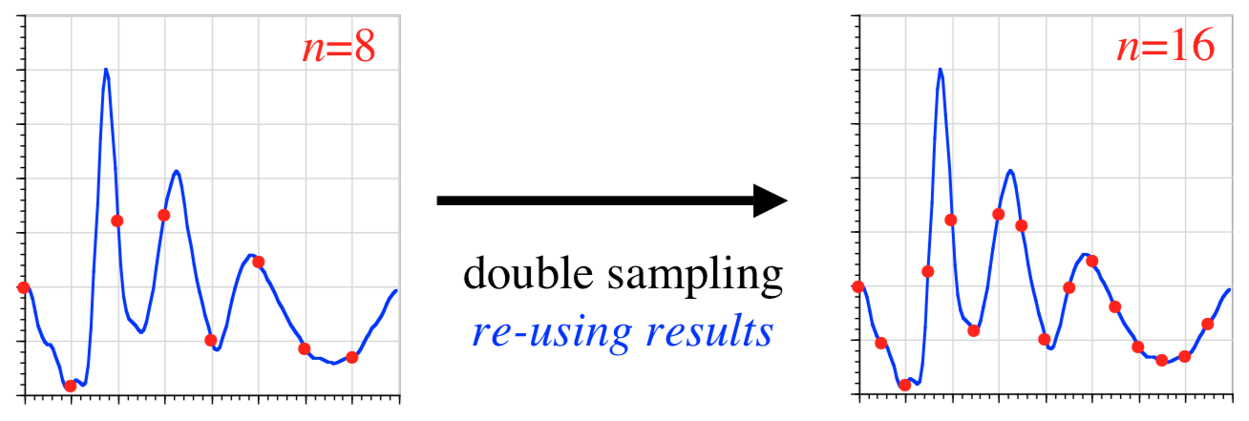
Gauss’ FFT in reverse: Danielson and Lanczos (1942)
[ J. Franklin Inst. 233, 365–380 and 435–452]
“By a certain transformation process, it is possible to double the number of ordinates with only slightly more than double the labor.”
from
O(n²) to ???
64-point DST in only 140 minutes!

Slide 8
re-inventing Gauss (for the last time) Cooley and Tukey (1965)
[ Math. Comp. 19,
297–301 ]
N = N₁N₂
1d DFT of size N:
= ~2d DFT of size N₁ × N₂
(+ phase rotation by twiddle factors)
= Recursive DFTs of sizes N₁ and N₂
O(N²)
O(N log N)
n=2048, IBM 7094, 36-bit float: 1.2 seconds
(~10⁶ speedup vs. Dan./Lanc.)

Slide 9
The “Cooley-Tukey” FFT Algorithm
N = N₁N₂
1d DFT of size N:
₀
₁
₂
₃
₄
…
n
= ~2d DFT of size N₁ × N₂
input re-indexing
n = n₁ + N₁n₂
N₁
output re-indexing
n₁
k = N₂k₁ + k₂
₀
₁
₂
multiply by n
“twiddle factors”
n₂
₃
₄
…
N₂
N₂
k₂
transpose
k₁
₀
₁
₂
₃
₄
…
N₁
= contiguous
first DFT columns, size N₂
(non-contiguous)
finally, DFT columns, size N₁
(non-contiguous)

Slide 10
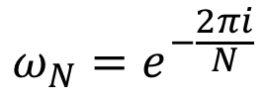
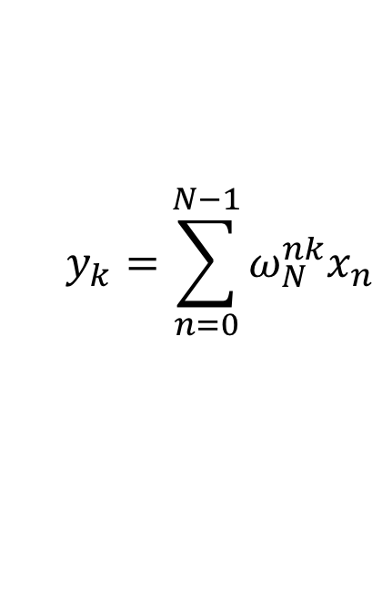
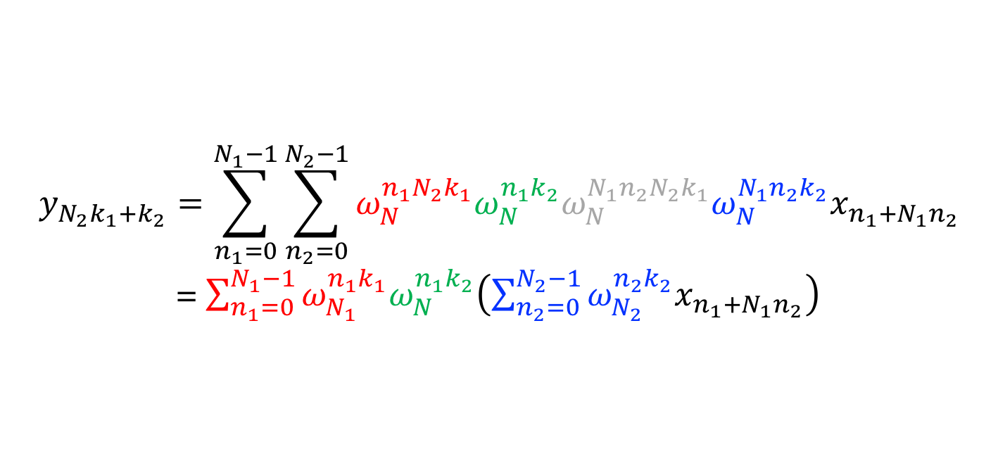
“Cooley-Tukey” FFT, in math
Recall the definition of the DFT:
$$y_{k}=\sum_{n=0}^{N−1}{ω_{N}^{nk}x_{n}}$$
$$ω_{N}=e^{−\frac{2πi}{N}}$$
where
Trick: if $N=N_{1}N_{2}$, re-index $n=n_{1}+N_{1}n_{2}$ and $k=N_{2}k_{1}+k_{2}$:
$$y_{N_{2}k_{1}+k_{2}}=\sum_{n_{1}=0}^{N_{1}−1}{\sum_{n_{2}=0}^{N_{2}−1}{ω_{N}^{n_{1}N_{2}k_{1}}ω_{N}^{n_{1}k_{2}}ω_{N}^{{N_{1}n}_{2}N_{2}k_{1}}ω_{N}^{{N_{1}n}_{2}k_{2}}x_{n_{1}+N_{1}n_{2}}}}$$
= $\sum_{n_{1}=0}^{N_{1}−1}{ω_{N_{1}}^{n_{1}k_{1}}ω_{N}^{n_{1}k_{2}}\left(\sum_{n_{2}=0}^{N_{2}−1}{ω_{N_{2}}^{n_{2}k_{2}}x_{n_{1}+N_{1}n_{2}}}\right)}$
size-N₁ DFTs
twiddles
size-N₂ DFTs
… repeat recursively.

Slide 11
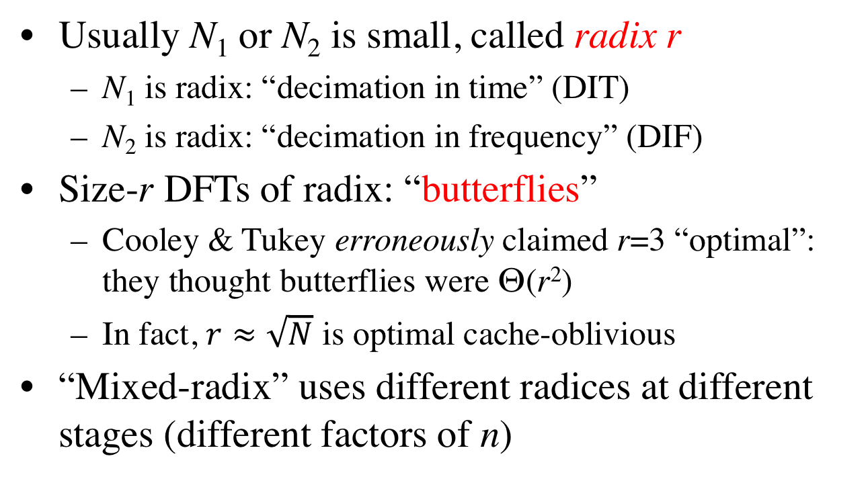
Cooley–Tukey terminology
Usually N₁ or N₂ is small, called radix r
N₁ is radix: “decimation in time” (DIT)
N₂ is radix: “decimation in frequency” (DIF)
Size-r DFTs of radix: “butterflies”
Cooley & Tukey erroneously claimed r=3 “optimal”: they thought butterflies were Θ(r²)
In fact, $r≈\sqrt{N}$ is optimal cache-oblivious
“Mixed-radix” uses different radices at different stages (different factors of n)

Slide 12
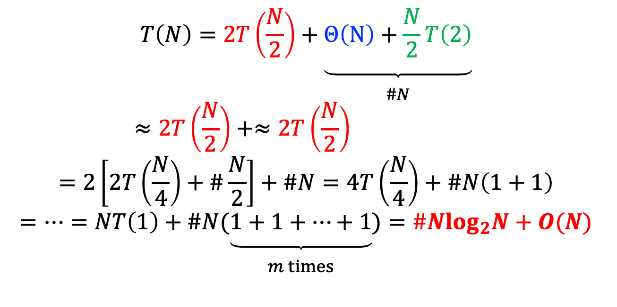
Why is Cooley–Tukey Θ(N log N)?
Take the radix-2 DIT case, and suppose N=2^{m}.
Size-N DFT is expressed as 2 size-N/2 DFTs +
multiplication by Θ(N) twiddle factors + N/2 size-2 DFTs:
$$T\left(N\right)=2T\left(\frac{N}{2}\right)+\underset{\begin{aligned} \\ \#\#\#\#\#\#\#\#N\end{aligned}}{\underbrace{Θ\left(N\right)+\frac{N}{2}T\left(2\right)}}$$
$$\begin{aligned}≈2T\left(\frac{N}{2}\right)+≈2T\left(\frac{N}{2}\right)\#\end{aligned}$$
$$=2\left[2T\left(\frac{N}{4}\right)+\#\frac{N}{2}\right]+\#N=4T\left(\frac{N}{4}\right)+\#N\left(1+1\right)$$
$$=…=NT\left(1\right)+\#N(\underset{\begin{aligned} \\ m times\end{aligned}}{\underbrace{1+1+…+1}})=\#Nlog_{2}N+O(N)$$
flop count for
size-N=2^{m} DFT:

Slide 13
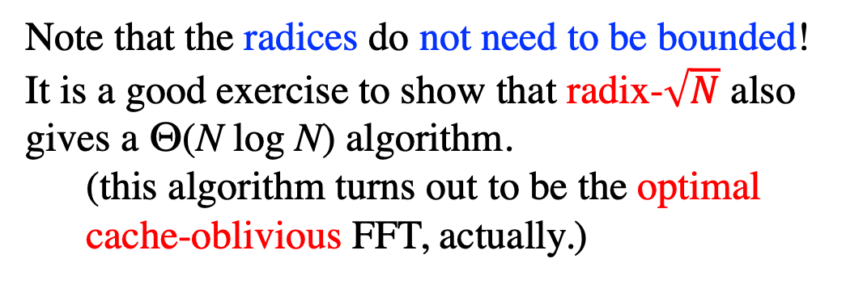
…similarly for any radices, as long as the base cases (= the prime factors of N) are bounded.
Note that the radices do not need to be bounded! It is a good exercise to show that radix-$\sqrt{N}$ also gives a Θ(N log N) algorithm.
(this algorithm turns out to be the optimal cache-oblivious FFT, actually.)

Slide 14
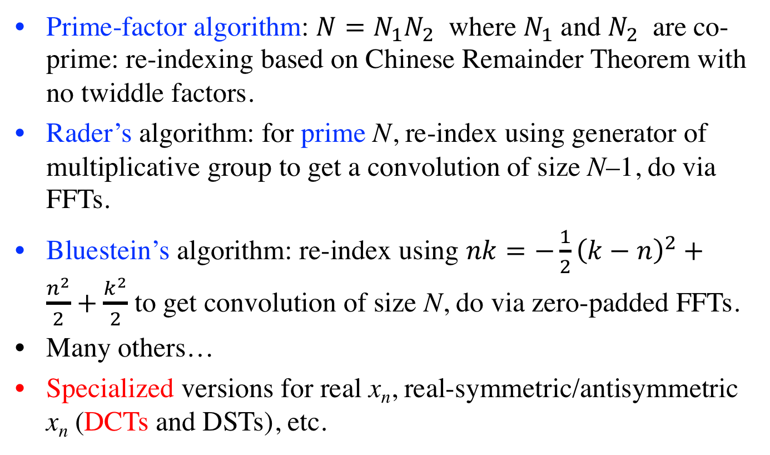
Many other FFT algorithms
Prime-factor algorithm: $N=N_{1}N_{2}$ where $N_{1}$ and $N_{2}$ are co-prime: re-indexing based on Chinese Remainder Theorem with no twiddle factors.
Rader’s algorithm: for prime N, re-index using generator of multiplicative group to get a convolution of size N–1, do via FFTs.
Bluestein’s algorithm: re-index using $nk=−\frac{1}{2}{\left(k−n\right)}^{2}+\frac{n^{2}}{2}+\frac{k^{2}}{2}$ to get convolution of size N, do via zero-padded FFTs.
Many others…
Specialized versions for real x_{n}, real-symmetric/antisymmetric x_{n} (DCTs and DSTs), etc.

Slide 15
…but how do we make it faster?
We (probably) cannot do better than Θ(n log n).
(the proof of this remains an open problem
… can prove it only under restrictive assumptions,
e.g. linear algorithms with bounded multiplicative constants)
[ unless we give up exactness ]
We’re left with the “constant” factor…

Slide 16
The Next 30 Years…
Assume “time”
= # multiplications
# multiplications + # additions (= flops)
Winograd (1979): # multiplications = Θ(n)
(…realizable bound! … but costs too many additions)
Yavne (1968): split-radix FFT, saves 20% over radix-2 flops
[ unsurpassed until last 2007, another ~6% saved
by Lundy/Van Buskirk and Johnson/Frigo ]

Slide 17
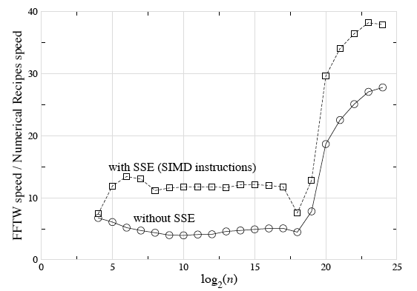
Are arithmetic counts so important?

Slide 18
The Next 30 Years…
Assume “time”
= # multiplications
# multiplications + # additions (= flops)
Winograd (1979): # multiplications = Θ(n)
(…realizable bound! … but costs too many additions)
Yavne (1968): split-radix FFT, saves 20% over radix-2 flops
[ unsurpassed until last 2007, another ~6% saved]
last 15+ years: flop count (varies by ~20%)
no longer determines speed (varies by factor of ~10+)

Slide 19
a basic question: If arithmetic no longer dominates, what does?

Slide 20
The Memory Hierarchy (not to scale)
disk (out of core) / remote memory (parallel)
(terabytes)
…what matters is not
how much work you
do, but when and where
you do it.
RAM (gigabytes)
L2 cache (megabytes)
the name of the game:
• do as much work as
possible before
going out of cache
L1 cache (10s of kilobytes)
registers (~100)
…difficult for FFTs
…many complications
…continually changing

Slide 21
What’s the fastest algorithm for _____? (computer science = math + time = math + $)
1
Find best asymptotic complexity
naïve DFT to FFT: O(n²) to O(n log n)
2
Find best exact operation count?
3
Find variant/implementation that runs fastest
hardware-dependent — unstable answer!
Better to change the question…

Slide 22
What’s the smallest set of “simple” algorithmic steps whose compositions ~always span the ~fastest algorithm?
A question with a more stable answer?

Slide 23
Lots of choices in FFT implementation
What is the base case? N=1 is elegant but inefficient.
What factorization of N (“radices”)?
Ordering of loops, memory layout?
Other FFT algorithms besides Cooley–Tukey?
Cooley–Tukey is only for composite N (often just 2^{m}), but there are FFT algorithms even for prime N.

Slide 24

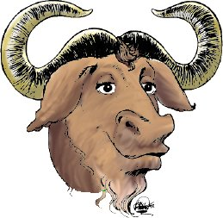
FFTW
the “Fastest
Fourier Transform
in the West”
S. G. Johnson
& Matteo Frigo
(1997)
• C library for real & complex FFTs (arbitrary size/dimensionality)
(+ parallel versions for threads & MPI)
• Computational kernels (80% of code) automatically generated
• Self-optimizes for your hardware (picks best composition of steps)
= portability + performance
free software: http://www.fftw.org
Julia interface: FFTW package
Matlab: it’s the default fft(...)

Slide 25
Started (1997) with a practical need and a benchmark
I was solving Maxwell’s equations with FFTs and needed: 3d, not just 2^{m}, parallel, portable.
My friend Matteo suggested his Cilk FFT …
I downloaded a bunch of other FFTs, benchmarked them, and put up a web page with results … no clear winner. Matteo:
Could we do better? Key principles:
Benchmark against every competitor you can — otherwise you can’t know if you did a good job.
Make it fast and portable, but…
Don’t sacrifice generality / practicality.
(& I turned it in as final project
in 18.337 taught by …
… Alan Edelman)

Slide 26
Why is FFTW fast?
FFTW implements many FFT algorithms:
A planner picks the best composition (plan)
by measuring the speed of different combinations.
Three ideas:
1
A recursive framework enhances locality.
2
Computational kernels (“codelets”)
should be automatically generated.
3
Self-optimizes algorithm compositions … the unit of composition is critical.

Slide 27
What does the planner compose?
• The Cooley-Tukey algorithm presents many choices:
— which factorization? what order? memory reshuffling?
Find simple steps that combine without restriction
to form many different algorithms.
… steps to do WHAT?
FFTW 1 (1997):
steps solve out-of-place DFT of size n

Slide 28
“Composable” Steps in FFTW 1
SOLVE — Directly solve a small DFT by a codelet
CT-FACTOR[r] — Radix-r Cooley-Tukey step =
execute loop of r sub-problems of size n/r
✗
Many algorithms difficult to express via simple steps.
— e.g. expresses only depth-first recursion (loop is outside of sub-problem)
— e.g. in-place without bit-reversal requires combining
two CT steps (DIT + DIF) + transpose

Slide 29
What does the planner compose?
• The Cooley-Tukey algorithm presents many choices:
— which factorization? what order? memory reshuffling?
Find simple steps that combine without restriction
to form many different algorithms.
… steps to do WHAT?
FFTW 1 (1997):
steps solve out-of-place DFT of size n
Steps cannot solve problems that cannot be expressed.

Slide 30
What does the planner compose?
• The Cooley-Tukey algorithm presents many choices:
— which factorization? what order? memory reshuffling?
Find simple steps that combine without restriction
to form many different algorithms.
… steps to do WHAT?
FFTW 3 (2003):
steps solve a problem, specified as a DFT(input/output, v,n):
multi-dimensional “vector loops” v of multi-dimensional transforms n
{sets of (size, input/output strides)}

Slide 31
Key component: The “Codelet” Generator
a domain-specific FFT “compiler”
• Generates fast hard-coded C for FFT of a given size
Necessary to give the planner a large space of base cases (“codelets”) to experiment with (any factorization).
Exploits modern CPU
deep pipelines & large register sets.
Allows easy experimentation with different optimizations & algorithms.
+ CPU-specific hacks (SIMD)…
(& large base case negates recursion overhead: “recursion coarsening”)

Slide 32
The Codelet Generator
written in Objective Caml [Leroy, 1998], an ML dialect
Abstract FFT algorithm
N
Cooley-Tukey: N=N₁N₂,
Prime-Factor: gcd(N₁,N₂) = 1,
Rader: N prime, …
Symbolic graph (dag)
Simplifications:
powerful enough
to e.g. derive real-input FFT
from complex FFT algorithm
and even find “new” algorithms
Optimal cache-oblivious
scheduling
(cache == registers)
Optimized C code (or other language)

Slide 33
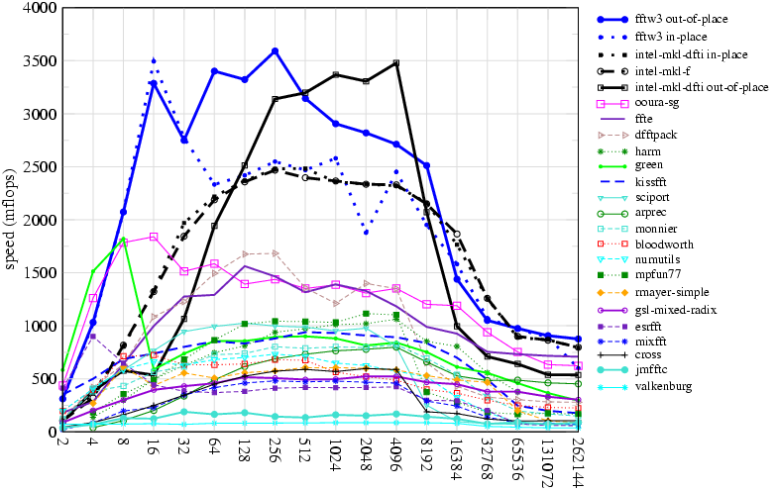
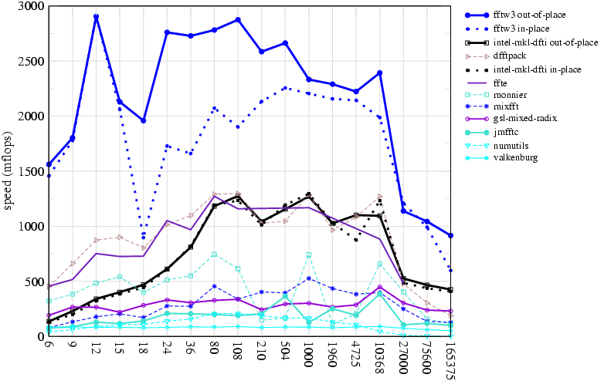
FFTW performance double precision, most recent benchmarks on fftw.org
… a 2.8GHz Pentium IV Prescott (2004)
Maybe I need to re-run the benchmark?
powers of two
non-powers-of-two
(If you don’t hand code or generate SIMD instructions,
you lose … compilers won’t save you for FFTs.)

Slide 34
Updated FFTW performance double precision, 3GHz Intel Core i5 (2018 Mac mini)
powers of two
non-powers-of-two
(If you don’t hand code or generate SIMD instructions,
you really lose … AVX2 etc. getting really wide.)

Slide 35
We’ve Come a Long Way?
•
In the name of performance, computers have become
complex & unpredictable.
•
Optimization is hard: simple heuristics (e.g. fewest flops)
no longer work.
•
One solution is to avoid the details, not embrace them:
(Recursive) composition of simple modules
+ feedback (self-optimization)
High-level languages (not C) & code generation
are a powerful tool for high performance.

Slide 36
A closing suggestion for numerical software
• Performance gets people’s attention.
… they don’t take you seriously without it.
… the “last factor of 2” is really hard to get,
& not worth it for most problems.
• Usability & generality keeps the attention.
FFTW was the first widely available FFT library that supported arbitrary (even prime) sizes, arbitrary dimensions, strides, real/complex data, DCTs/DSTs, & parallelism … without that, it would have just been a hack for benchmark bragging.

